Slide 1
Contemporary Moral Problems
M-F12:00-1:00SAV 264
Instructor: Benjamin Hole
Office Hours: everyday after class
Email: bvhole@uw.edu
Arguments in support of the Harm Principle
Fallibility
Dead Dogma
Mixture of Truth and Falsity
Danger of Government
The Importance of Local Knowledge
Active Character

Slide 2

Agenda
CLICKER QUIZ
Mill’s On Liberty
Arguments in support of the Harm Principle
Fallibility
Dead Dogma
Mixture of Truth and Falsity
Danger of Government
The Importance of Local Knowledge
Active Character

Slide 3
According to Mill, is it right for a government to deny its own citizens their experiments in living, when those citizens do not harm any non-consenting other person?
no, it is never right
no, at least not most of the time
yes, it is sometimes right
yes, it is always right
none of the above

Slide 4
Mill holds that even if only one individual holds a particular minority opinion:
the individual’s minority opinion should not be discussed
the individual’s minority opinion should be discussed
the individual’s minority opinion should be kept to him or herself
none of the above

Slide 5
Which of the following characters is not from an example discussed in Mill’s On Liberty?
Jesus Christ
Socrates
Immanuel Kant
All of the above
None of the above

Slide 6
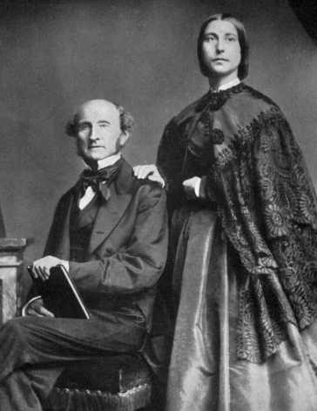
MILL’S ON LIBERTY
Review of yesterday
Review of Bentham
Mill’s autobiography
Mill’s Qualitative Hedonism
Mill’s Rule Utilitarianism
Collapse of RU argument
Introduction to sociopolitical ethics (basic terminology)

Slide 7
THE HARM PRINCIPLE
“If all mankind minus one were of one opinion, and only one person were of the contrary opinion, mankind would be no more justified in silencing that one person than he, if he had the power, would be justified in silencing mankind.”

Slide 8
THE HARM PRINCIPLE
In the absence of some direct harm to a non-consenting other person, there is no justification for coercion designed to prevent an action.
This is a radical principle, since it would allow many things we might not …

Slide 9
Rejection of Moralism
Moralism argues that some things may be wrong even if there is no non-consenting person that is harmed.
Also called: harmless wrongdoing, e.g.
Some forms of pornography
Some forms of bestiality
Some forms of incest
Consensual cannibalism

Slide 10
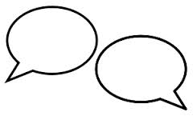
Mill’s arguments
In support of the Harm Principle
Fallibility
Dead Dogma
Mixture of Truth and Falsity
Danger of Government
The Importance of Local Knowledge
Active Character

Slide 11

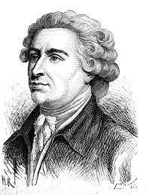
Mill’s arguments
Fallibility. Received wisdom has often been completely wrong. Mill’s examples: Jesus and Socrates.
Those who killed Jesus and Socrates were the solid citizens of their societies; they were received wisdom. They were also wrong.
Rejection of conservativism

Slide 12
Mill on Fallibility
Strongly Agree
Agree
Somewhat Agree
Neutral
Somewhat Disagree
Disagree
Strongly Disagree

Slide 13
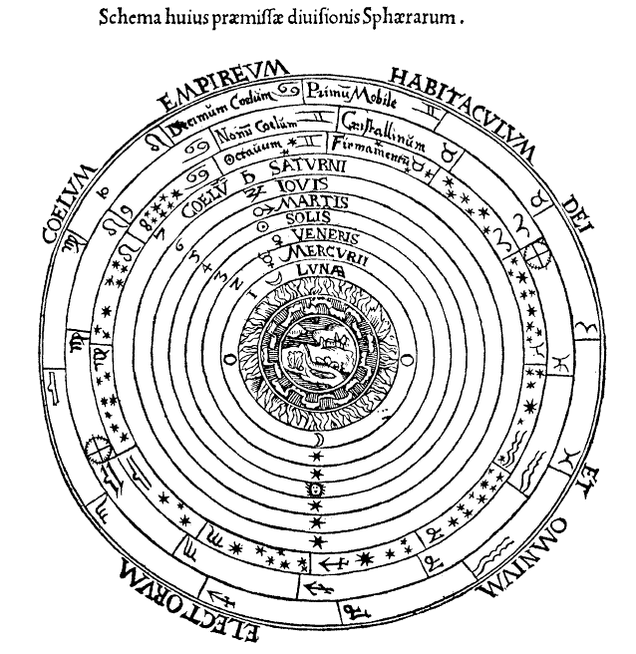
Mill’s arguments
Dead dogma. Unless a belief is regularly challenged, we lose track of why we believe. We should thus welcome heretics, mockers, and infidels. If we use coercion to quiet them, we lose a chance to understand ourselves.
Notes:
Example : Christianity

Slide 14
Mill on Dead Dogma
Strongly Agree
Agree
Somewhat Agree
Neutral
Somewhat Disagree
Disagree
Strongly Disagree

Slide 15
Mill’s arguments
3. Mixed truth and falsity. The most likely situation. Where received opinion is neither totally right nor totally wrong, we lose a chance to improve it if we stop heresy. We need disagreement and dispute to make our ideas better.
Rationalism vs. Empiricism

Slide 16
Mill on mixture of truth and falsity
Strongly Agree
Agree
Somewhat Agree
Neutral
Somewhat Disagree
Disagree
Strongly Disagree

Slide 17
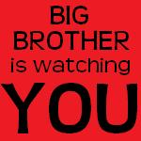
Mill’s arguments
4. Dangers of government action. Even if the government could legitimately constrain speech some times, it wouldn’t do this well . . . or infrequently.

Slide 18
Mill on The Dangers of Government
Strongly Agree
Agree
Somewhat Agree
Neutral
Somewhat Disagree
Disagree
Strongly Disagree

Slide 19
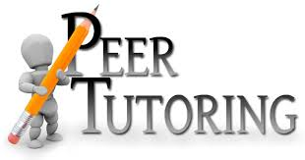
Mill’s arguments
5. Importance of local knowledge. We know ourselves better than other people do; even if we could come up with good rules, they would likely be misapplied by those who don’t understand us.

Slide 20
Mill on Local Knowledge
Strongly Agree
Agree
Somewhat Agree
Neutral
Somewhat Disagree
Disagree
Strongly Disagree

Slide 21
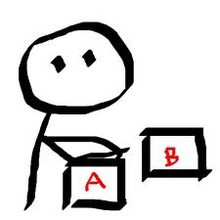
Mill’s arguments
6. Active characters. Choice is a sort of muscle; to grow, we require options, alternatives, and the space for deliberation. This is at the heart of Mill’s revised utilitarianism.

Slide 22
Mill on active character
Strongly Agree
Agree
Somewhat Agree
Neutral
Somewhat Disagree
Disagree
Strongly Disagree

Slide 23
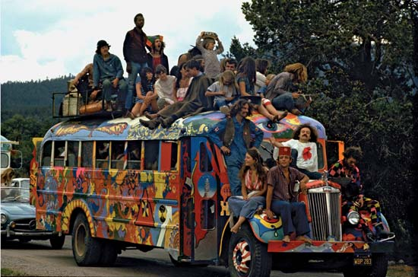
These arguments also apply to actions!
We ought to welcome and encourage heretics and those who introduce novelty into society; Mill calls for the promotion of “experiments in living.”

Slide 24
Mill’s harm Principle
Strongly Agree
Agree
Somewhat Agree
Neutral
Somewhat Disagree
Disagree
Strongly Disagree

Slide 25
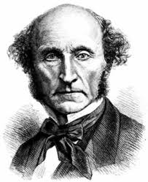
Mill’s Hedonistic Utilitarianism
Review
Theory of the Right
Theory of the Good
Review what each of these are for Mill and some of the biggest objections to each.

Slide 26
“it is better to be a human being dissatisfied than a pig satisfied; better to be Socrates dissatisfied than a fool satisfied”
Strongly Agree
Agree
Somewhat Agree
Neutral
Somewhat Disagree
Disagree
Strongly Disagree

Slide 27
The Collapse of Rule Consequentialism
“Either rule-consequentialism collapses into practical equivalence with the simpler act-consequentialism, or rule-consequentialism is incoherent.” (http://plato.stanford.edu/entries/consequentialism-rule/)
If RC collapses, it is not a viable ethical theory.
It is not a different theory than act consequentialism (and therefore also vulnerable to the same objections).
If RC is incoherent, it is not a viable ethical theory.
It depends on a theory of The Right; it takes a system or rules as primary and not value.
Therefore, RC is not a viable ethical theory.

Slide 28
Is RC a viable ethical theory?
Yes
No

Slide 29
Mill’s harm Principle
Strongly Agree
Agree
Somewhat Agree
Neutral
Somewhat Disagree
Disagree
Strongly Disagree

